Slide 1
CPS2 PROJECT
Presented by
Dharmalingam Dhayananth
Aninda Maulik

Slide 2
Context and motivation of the Work

Slide 3
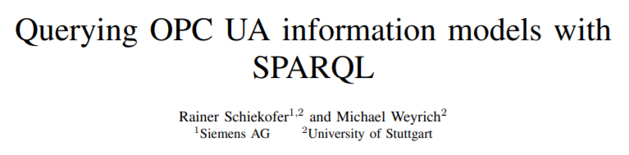

Slide 4
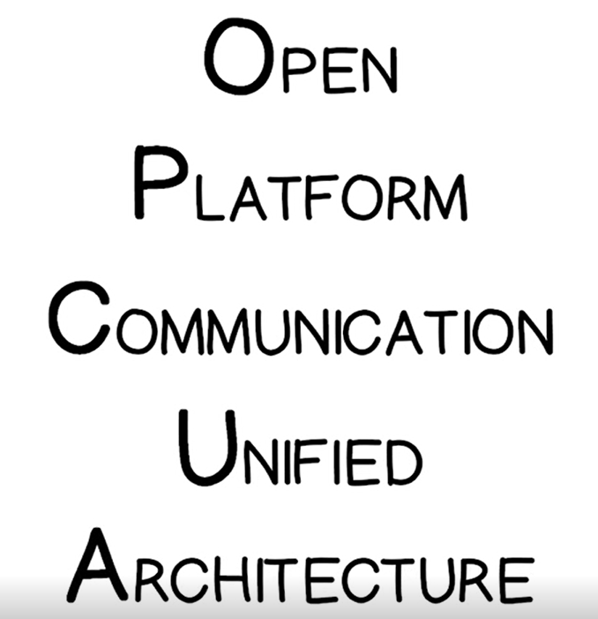

Slide 5
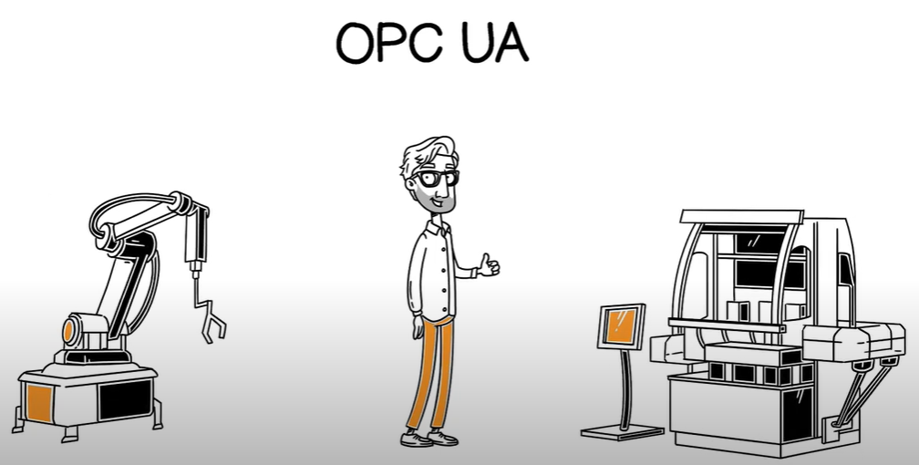
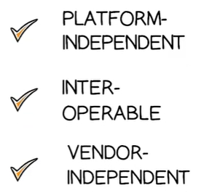

Slide 6


Slide 7
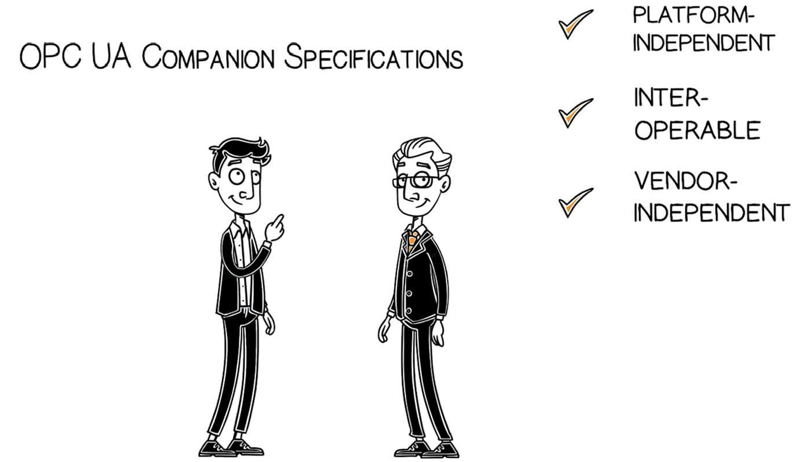

Slide 8
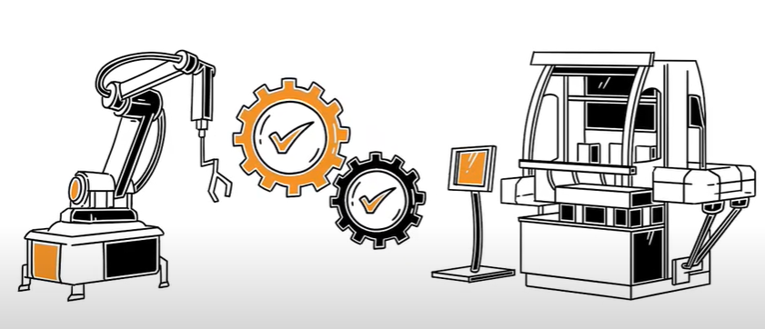
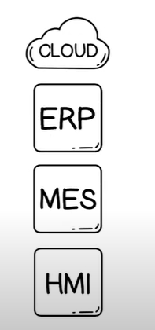

Slide 9
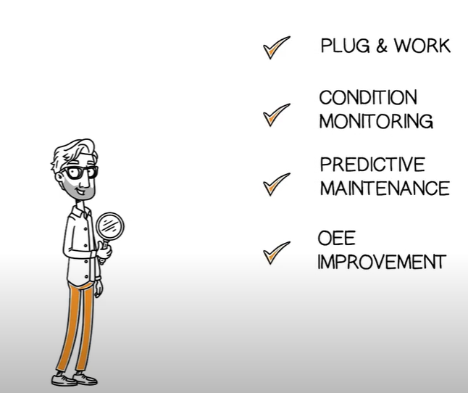

Slide 10
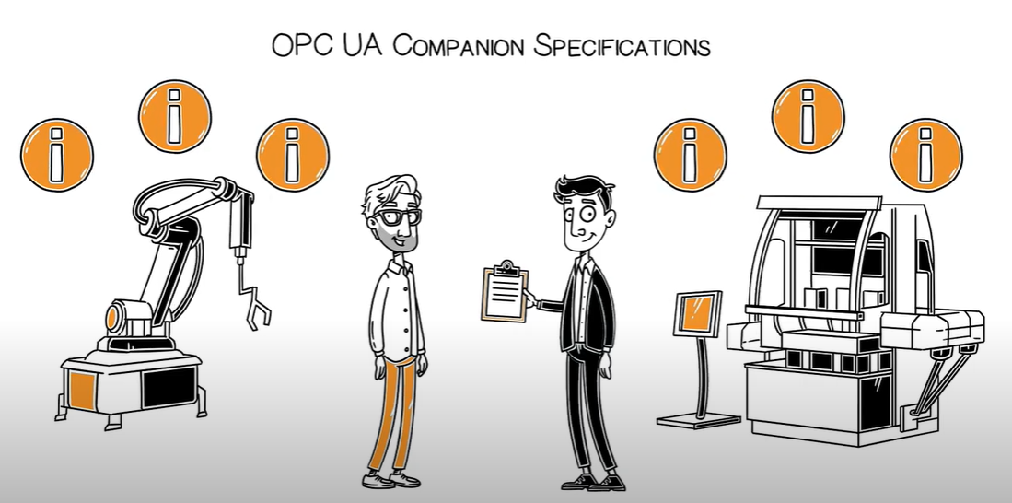

Slide 11
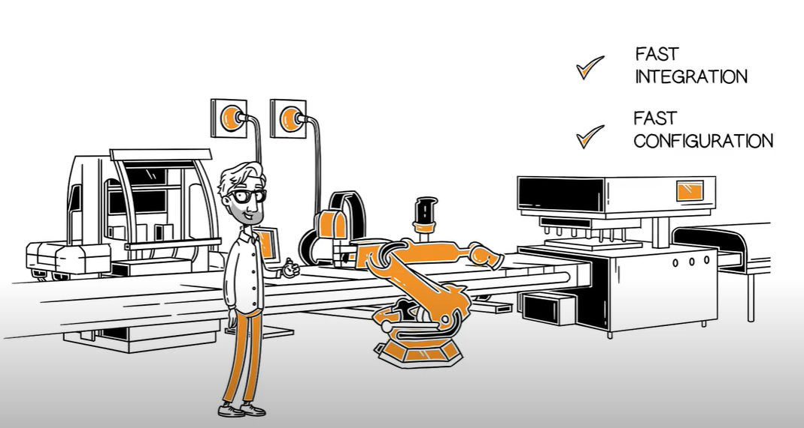
VDMA,2018

Slide 12
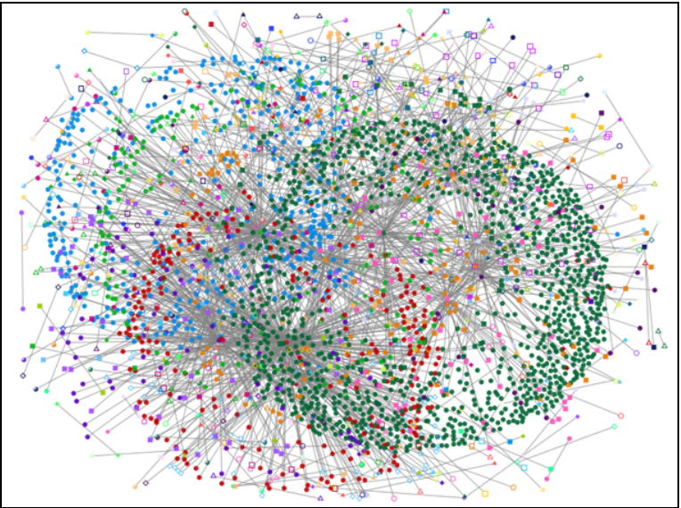

Slide 13
Objective Propose an efficiently query system that would query the huge graph data
Query OPC UA graphs through SparQl
Transform OPC UA queries to SparQl
Bypass the flaws through SparQl

Slide 14
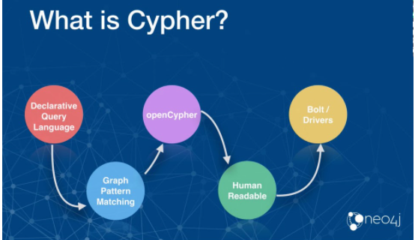
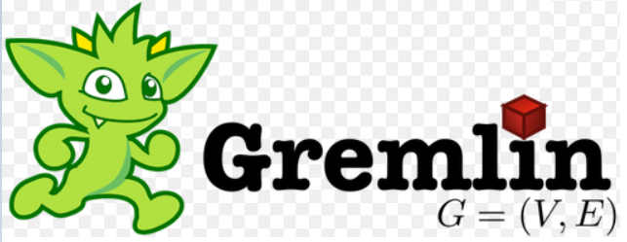
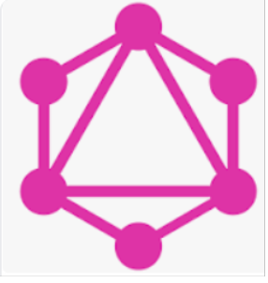
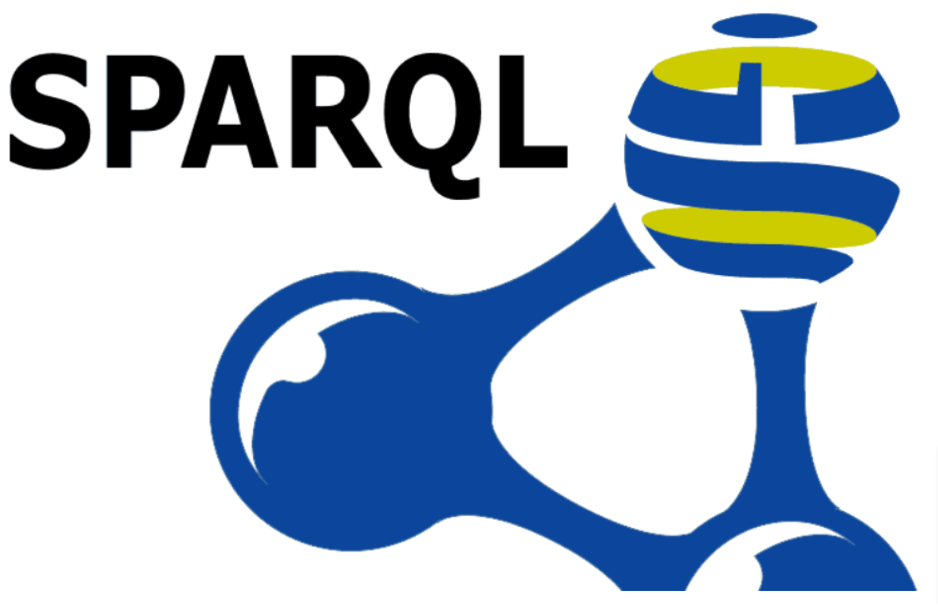
Research Questions
OPC UA produces huge connected graphs
Is OPC UA query system, capable to query such huge connected graphs?
How can OWL be integrated into the automation standard of OPC UA?

Slide 15
Your opinion on the proposal: what is reusable, why and how,
IIOT
IOT
Using SPARQL to Query BioPortal Ontologies and Metadata
Performance Evaluation of Storage-Independent Model for SPARQL-to-SQL Translation Algorithms
A Semantic Bayesian Network for Web Mashup Network Construction

Slide 16
what raises questions, doubts and why,
9 example queries of OPC UA

